Slide 1
Image Processing and Pattern Recognition (IPPR):
(Lecture 3)

Slide 2
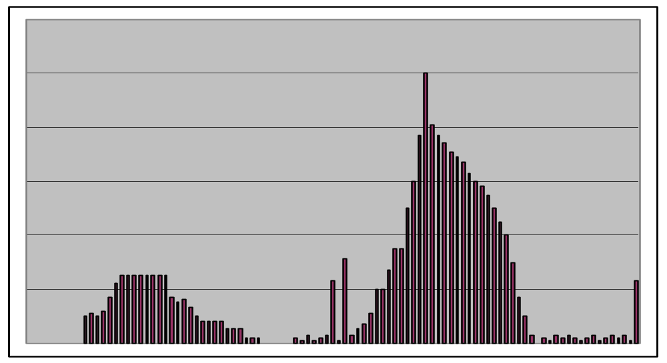
Image Histograms
The histogram of an image shows us the distribution of grey levels in the image
Massively useful in image processing, especially in segmentation
Frequencies
Grey Levels

Slide 3
Image Histograms
• The histogram of a digital image, f, (with intensities [0,L-1]) is a discrete function
h(rk) = nk
• Where rk is the kth intensity value and nk is the number of
pixels in f with intensity rk
• Normalizing the histogram is common practice – Divide the components by the total number of pixels in the image – Assuming an MxN image, this yields
p(rk) = nk/MN for k=0,1,2,....,L-1 – p(rk) is, basically, an estimate of the probability of occurrence of intensity level rk in an image Σ p(rk) = 1

Slide 4
Uses for Histogram Processing
• Image enhancements
• Image statistics
• Image compression
• Image segmentation
• Simple to calculate in software
• Economic hardware implementations
– Popular tool in real-time image processing
• A plot of this function for all values of k provides a global description of the appearance of the image (gives useful information for contrast enhancement)
• Histograms commonly viewed in plots as
h(rk) = nk versus rk
p(rk) = nk /MN versus rk

Slide 5
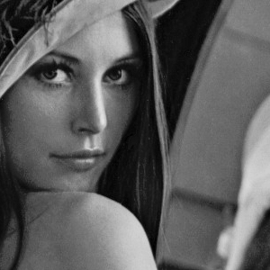

Histogram Examples
Images taken from Gonzalez & Woods, Digital Image Processing (2002)

Slide 6
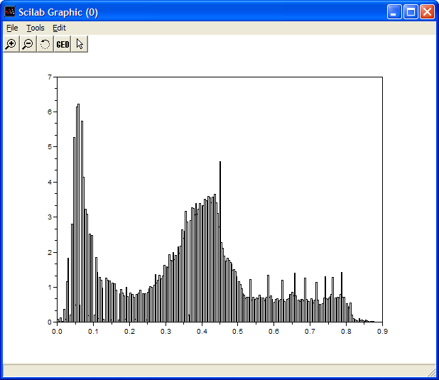
Histogram Examples (cont…)
Images taken from Gonzalez & Woods, Digital Image Processing (2002)

Slide 7

Histogram Examples (cont…)
Images taken from Gonzalez & Woods, Digital Image Processing (2002)

Slide 8
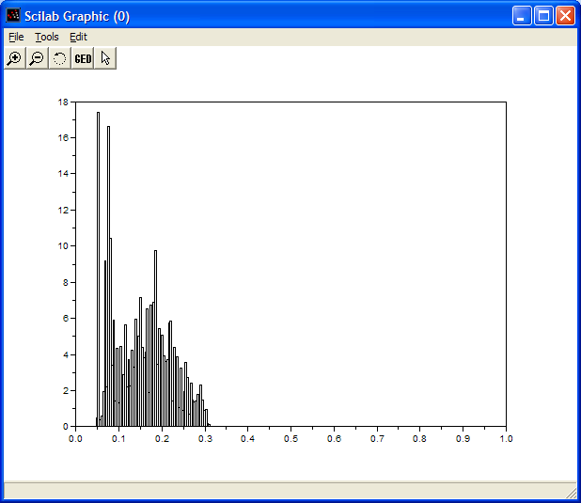
Histogram Examples (cont…)
Images taken from Gonzalez & Woods, Digital Image Processing (2002)

Slide 9
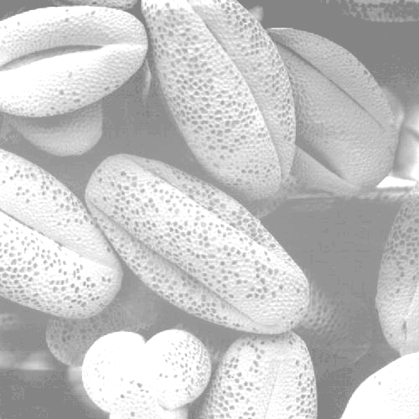
Histogram Examples (cont…)
Images taken from Gonzalez & Woods, Digital Image Processing (2002)

Slide 10
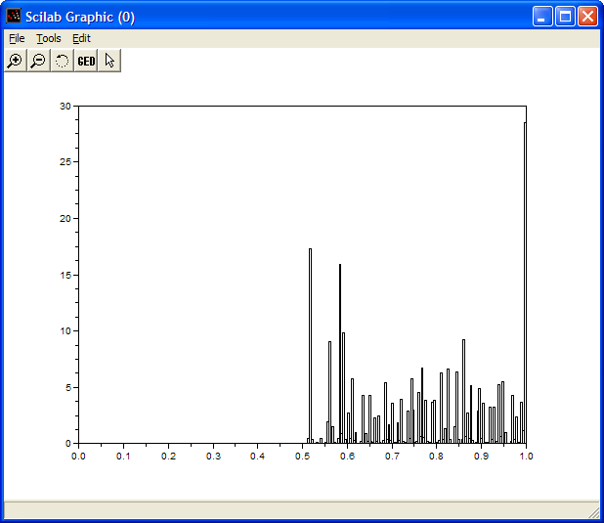
Histogram Examples (cont…)
Images taken from Gonzalez & Woods, Digital Image Processing (2002)

Slide 11

Histogram Examples (cont…)
Images taken from Gonzalez & Woods, Digital Image Processing (2002)

Slide 12
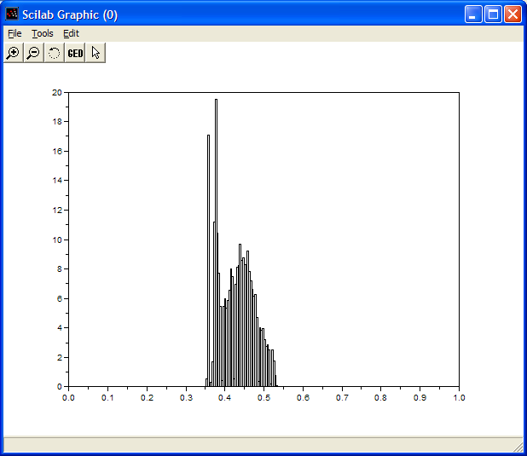
Histogram Examples (cont…)
Images taken from Gonzalez & Woods, Digital Image Processing (2002)

Slide 13
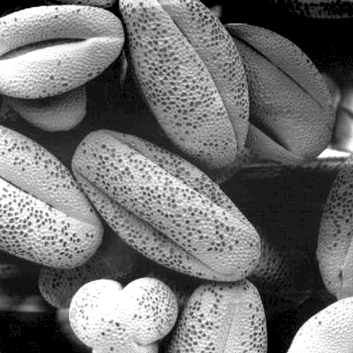
Histogram Examples (cont…)
Images taken from Gonzalez & Woods, Digital Image Processing (2002)

Slide 14
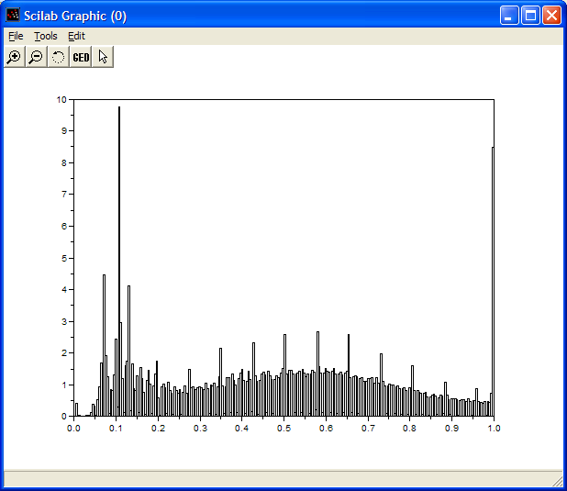
Histogram Examples (cont…)
Images taken from Gonzalez & Woods, Digital Image Processing (2002)

Slide 15
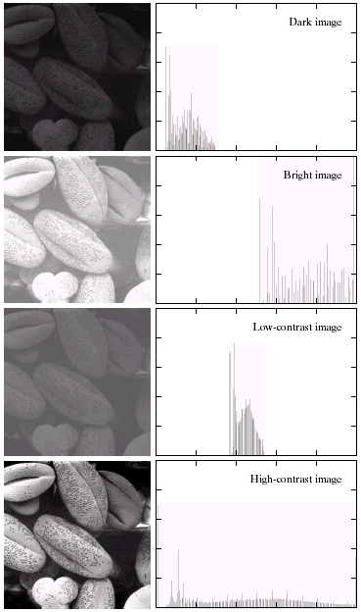
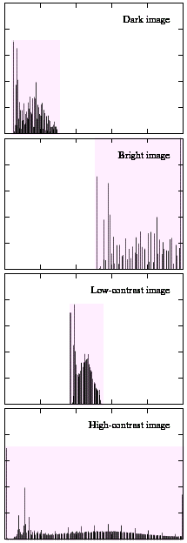
Histogram Examples (cont…)
A selection of images and
their histograms
Notice the relationships
between the images and
their histograms
Note that the high contrast
image has the most
evenly spaced histogram
Images taken from Gonzalez & Woods, Digital Image Processing (2002)

Slide 16
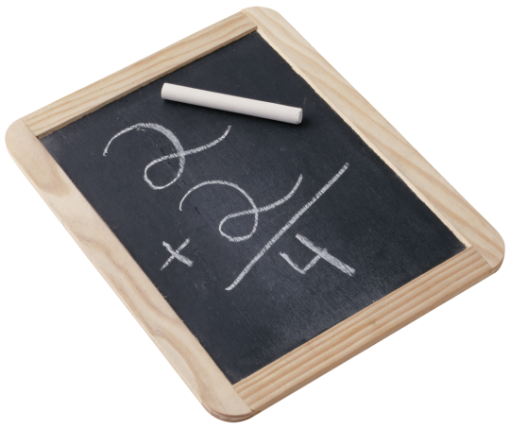
Contrast Stretching
We can fix images that have poor contrast by applying a pretty simple contrast specification
The interesting part is how do we decide on this transformation function?

Slide 17
Histogram Equalisation
• Histogram equalization is a process for increasing the contrast in an image by spreading the histogram out to be approximately uniformly distributed
• The gray levels of an image that has been subjected to histogram equalization are spread out and always reach white
– The increase of dynamic range produces an increase in contrast
• For images with low contrast, histogram equalization has the adverse effect of increasing visual graininess

Slide 18
Histogram Equalisation
• The intensity transformation function we are constructing is of the form
s=T(r) 0 ≤ r ≤ L−1
• An output intensity level s is produced for every pixel in the input image having intensity r
• We assume
– T(r) is monotonically increasing in the interval 0≤ r ≤ L-1
– 0 ≤ Τ(r) ≤ L-1 for 0 ≤ r ≤ L-1
• If we define the inverse
r=T^−1(s) 0 ≤ s ≤ L−1
• Then T(r) should be strictly monotonically increasing

Slide 19
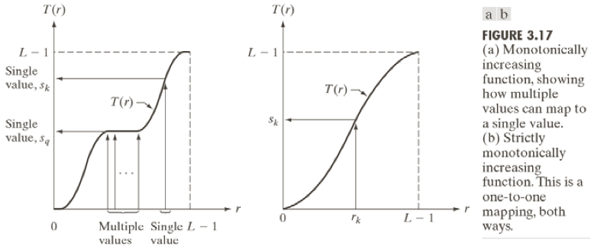
Histogram Equalisation

Slide 20

Histogram Equalisation
• Histogram equalization requires construction of a transformation function sk
• where rk is the kth gray level, nk is the number of pixels with that gray level, MxN is the number of pixels in the image, and k=0,1,...,L-1
• This yields an s with as many elements as the original image’s histogram (normally 256 for our test images)
• The values of s will be in the range [0,1]. For constructing a new image, s would be scaled to the range [1,256]

Slide 21
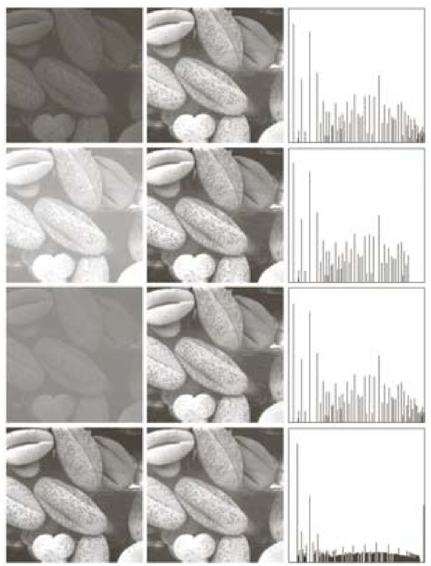
Histogram Equalisation

Slide 22
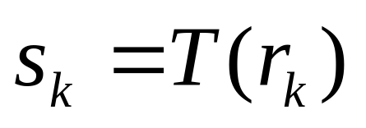
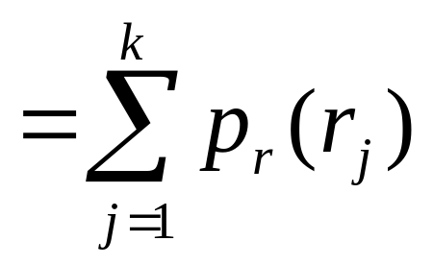
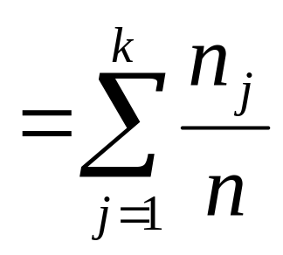
Histogram Equalisation
Spreading out the frequencies in an image (or equalising the image) is a simple way to improve dark or washed out images
The formula for histogram equalisation is given where
  r_{k}: input intensity
  s_{k}: processed intensity
  k: the intensity range
  (e.g 0.0 – 1.0)
  n_{j}: the frequency of intensity j
  n: the sum of all frequencies
The transformation function in the next slide is
Obtained by applying the RHS formula to the
Original image in the next side.

Slide 23
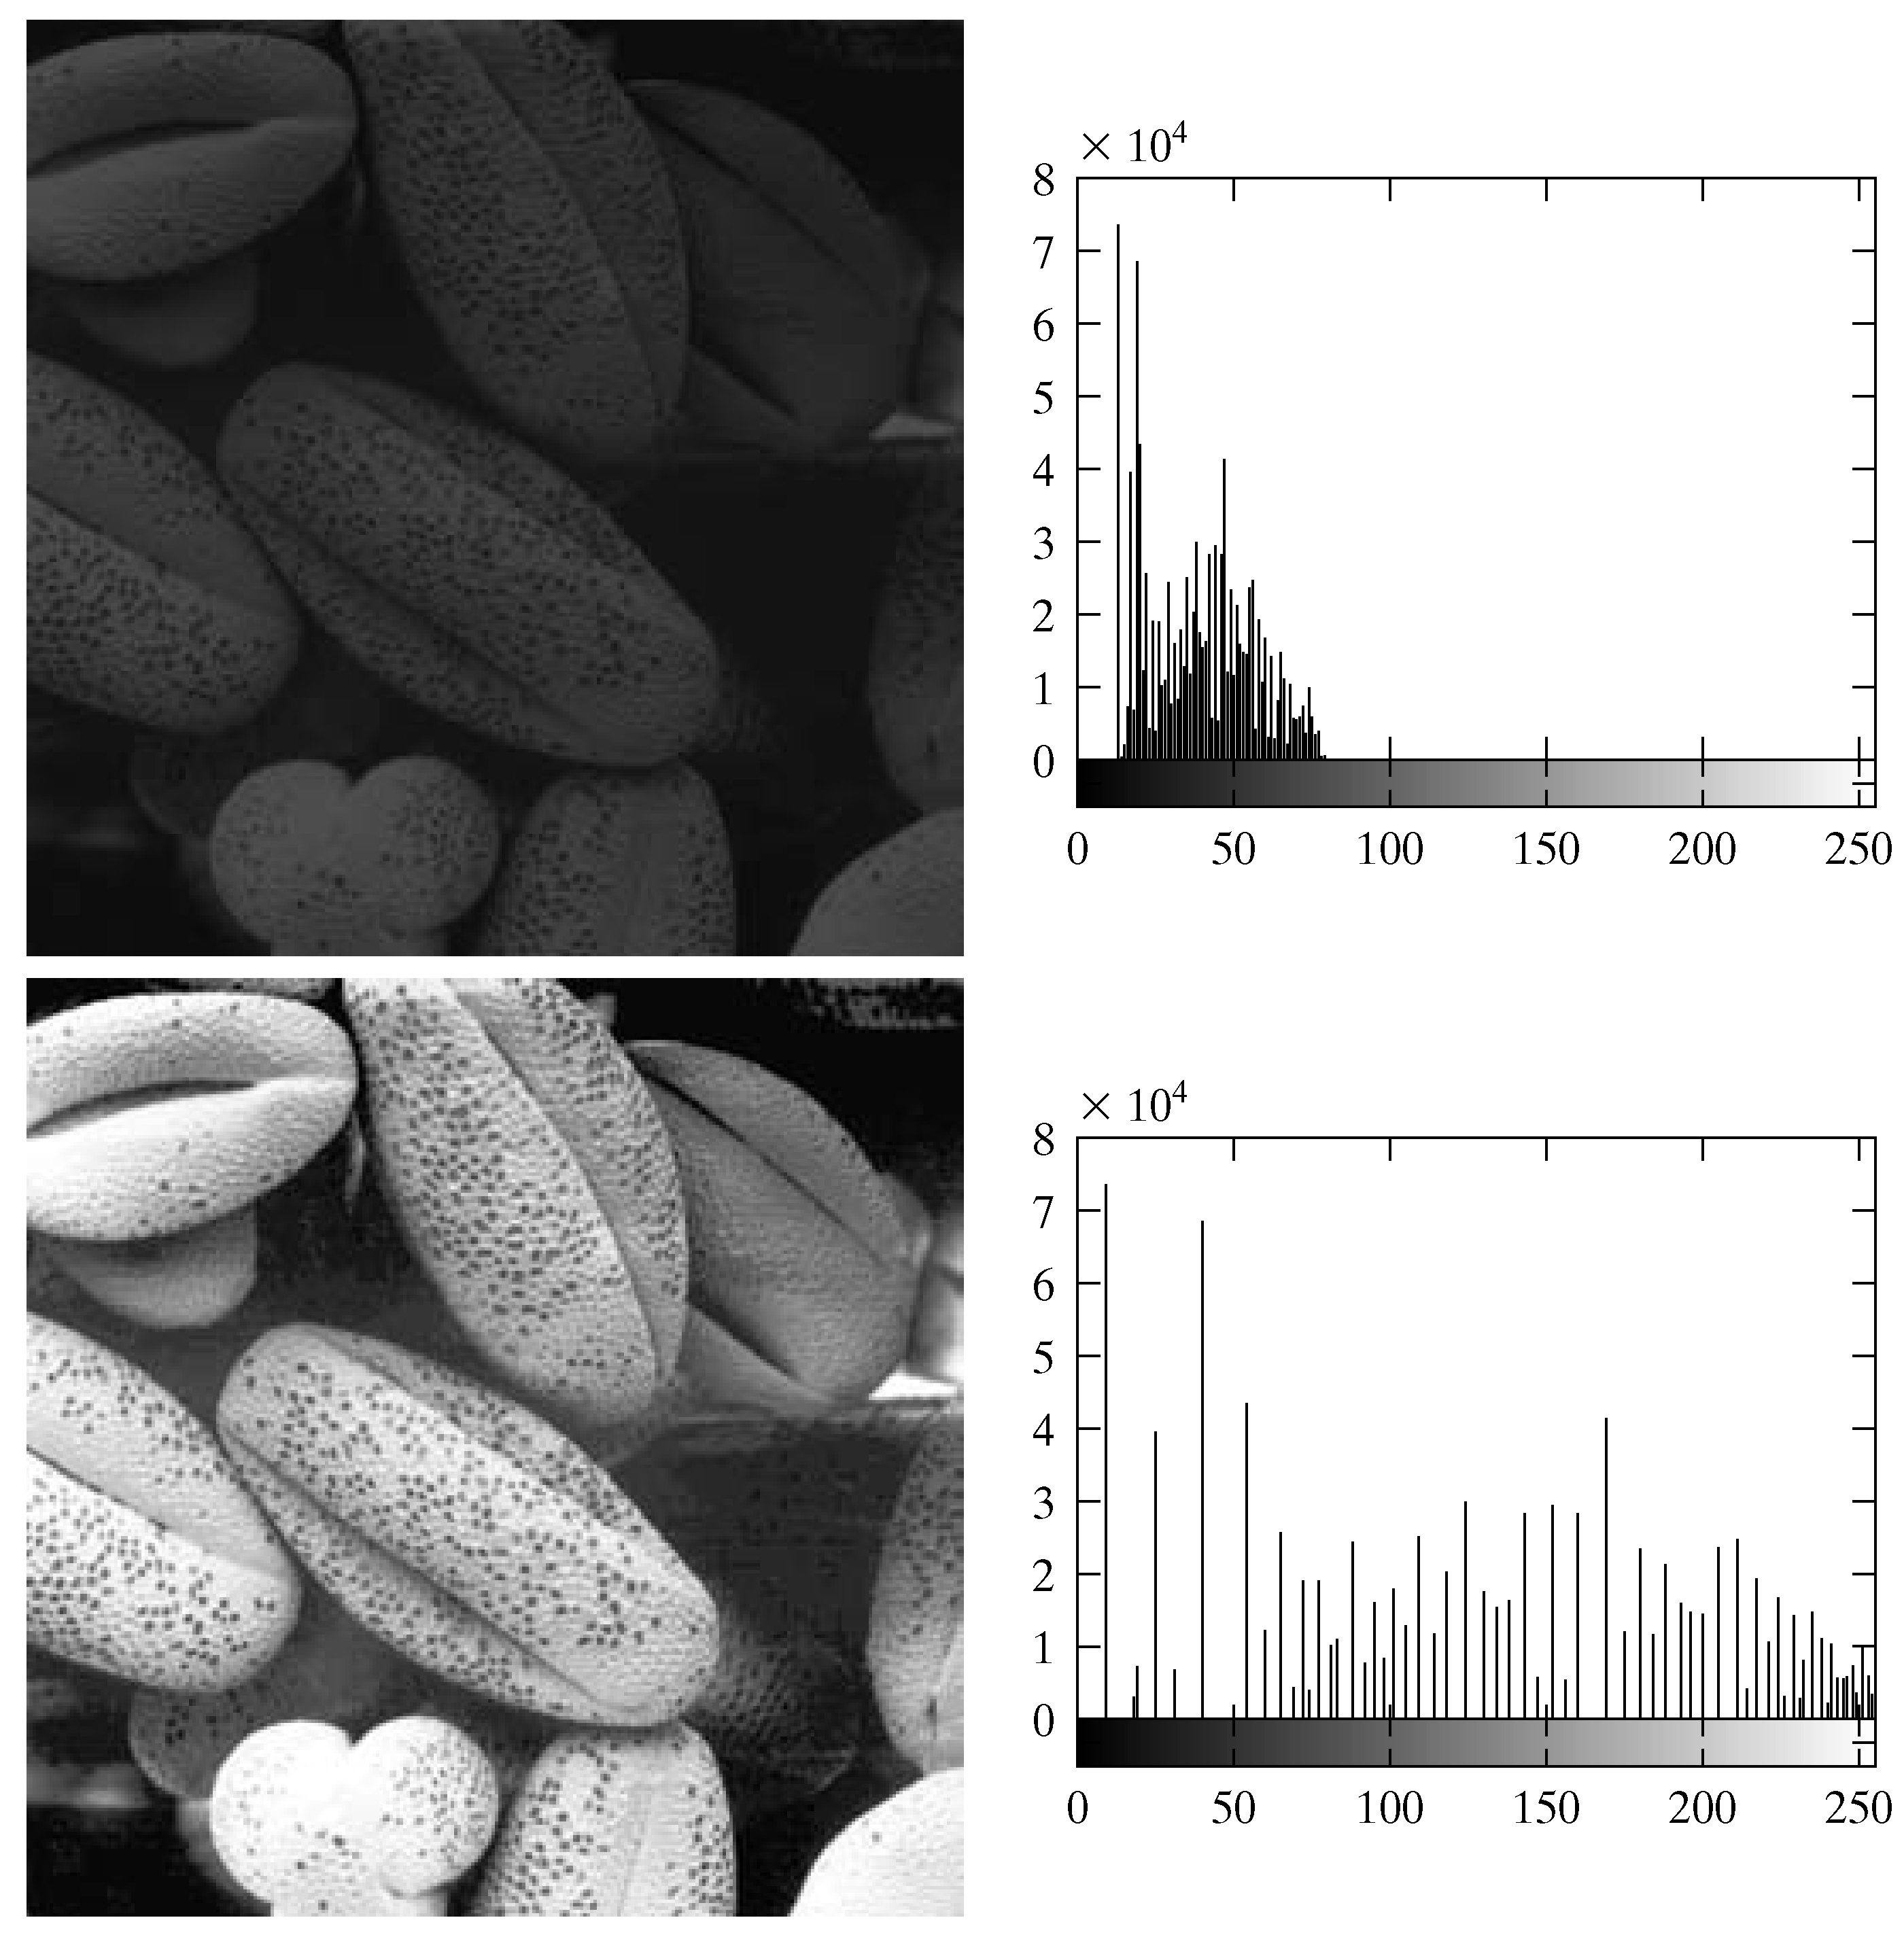
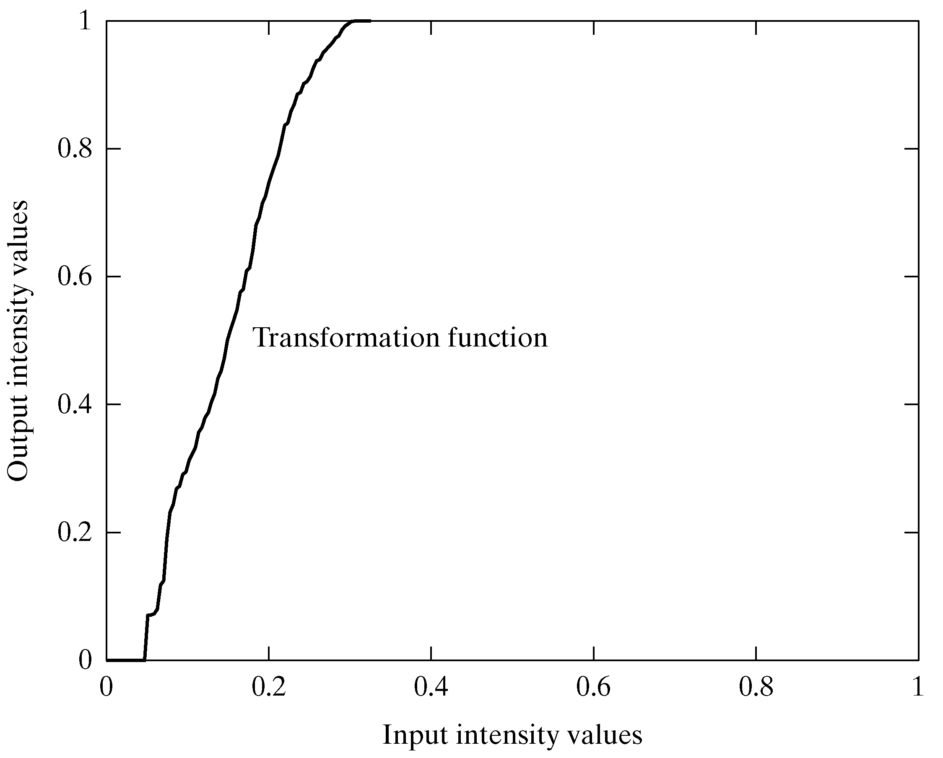
Equalisation Transformation Function
Images taken from Gonzalez & Woods, Digital Image Processing (2002)

